Slide 1
Machine Learning
An Analysis of Urban Sound Classifications
University of Richmond’s Data Analytics Bootcamp
Spring 2019

Slide 2
Objective
Take urban sound classification data and predict the likelihood that it is a certain sound using machine learning & deep learning models
10 sound classifications
Siren, Jackhammer, Dog Bark, Children Playing, Street Music, Engine Idling, Drilling, Gun Shot, Air Conditioner, Car Horn
The data is in .wav files and represent numbers that had to be parsed and labeled in order to train, fit and test it
Feature data represents the following types
mfcss - mel frequency cepstral coefficients/ Representation of an audio clip
chroma- pitch class profiles
mel- scales of pitches
contrast- difference in how sounds are perceived by listeners
tonnetz- notes (E#, A#, E-flat, etc…)

Slide 3
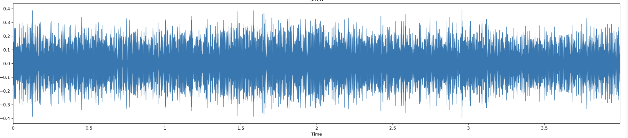
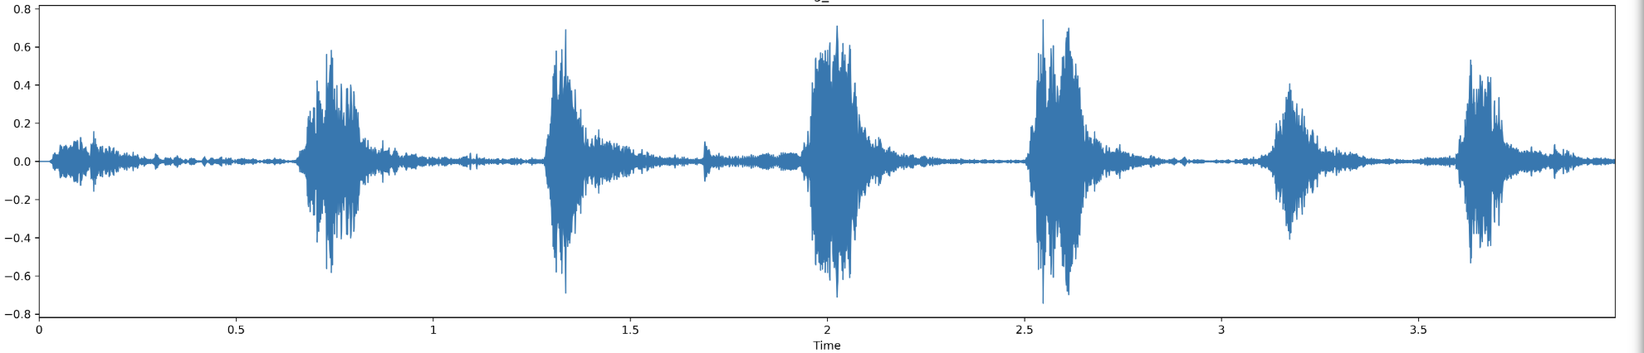

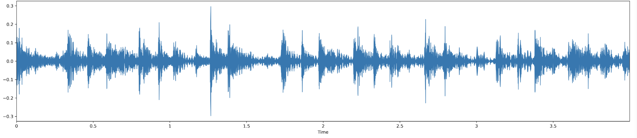
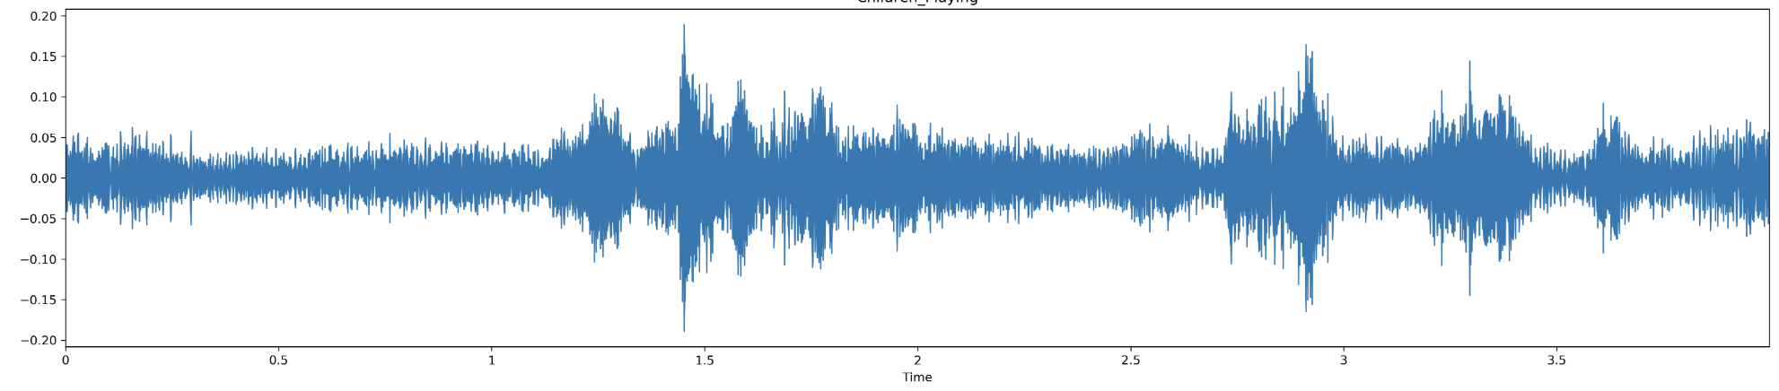
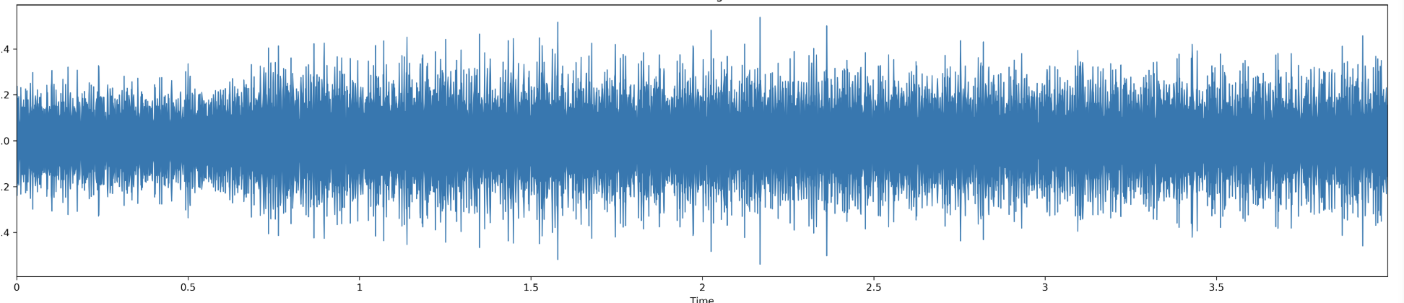
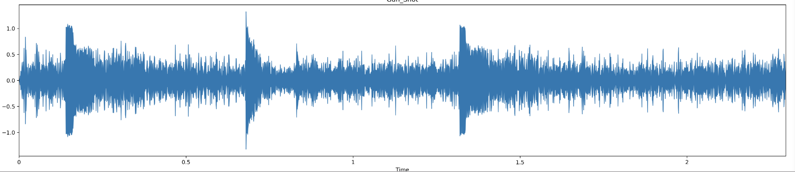
Sound Classifications
Siren
Dog Barking
Street Music
Children Playing
Drilling
Gun Shot

Slide 4
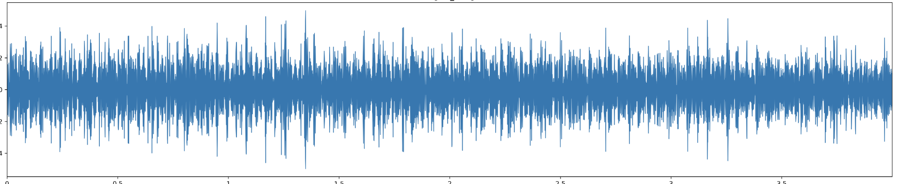
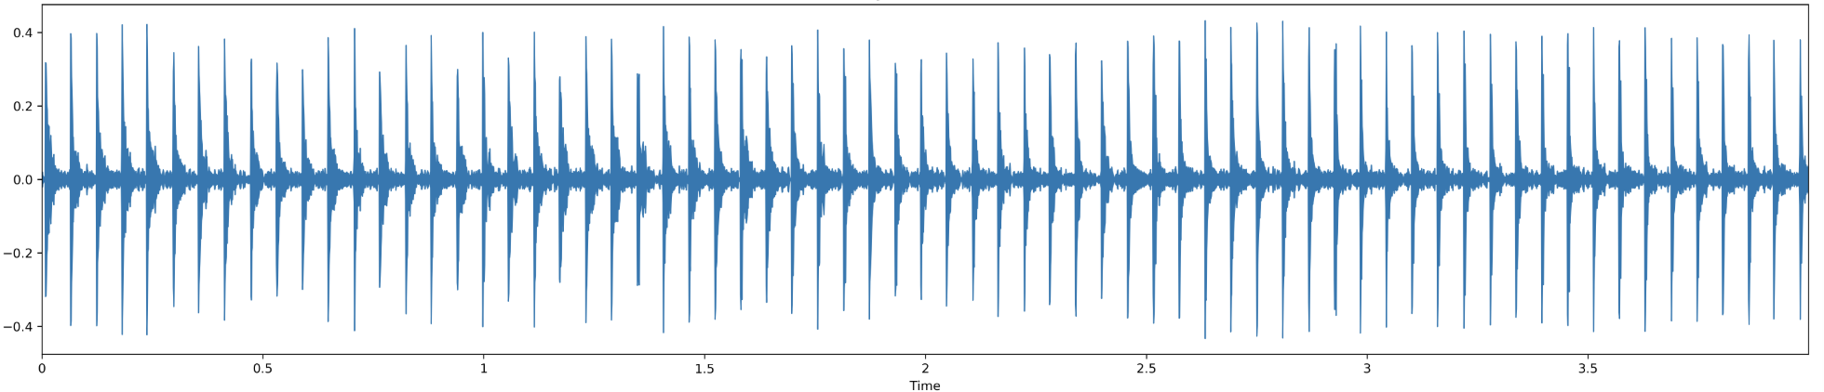
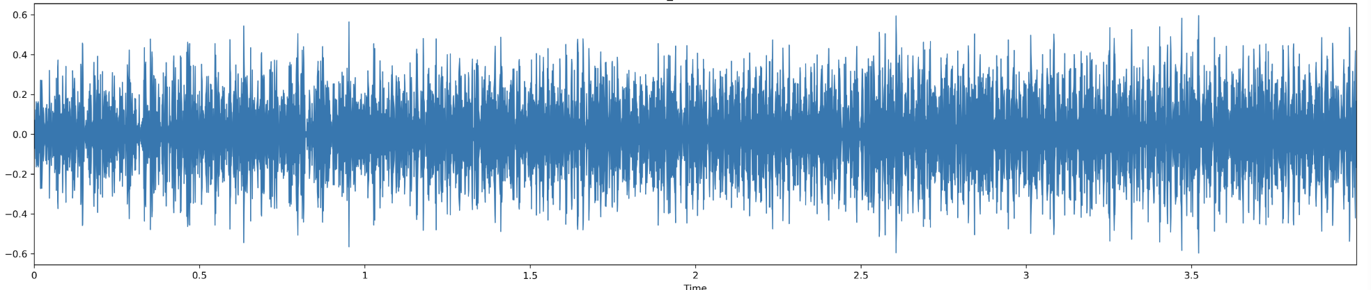
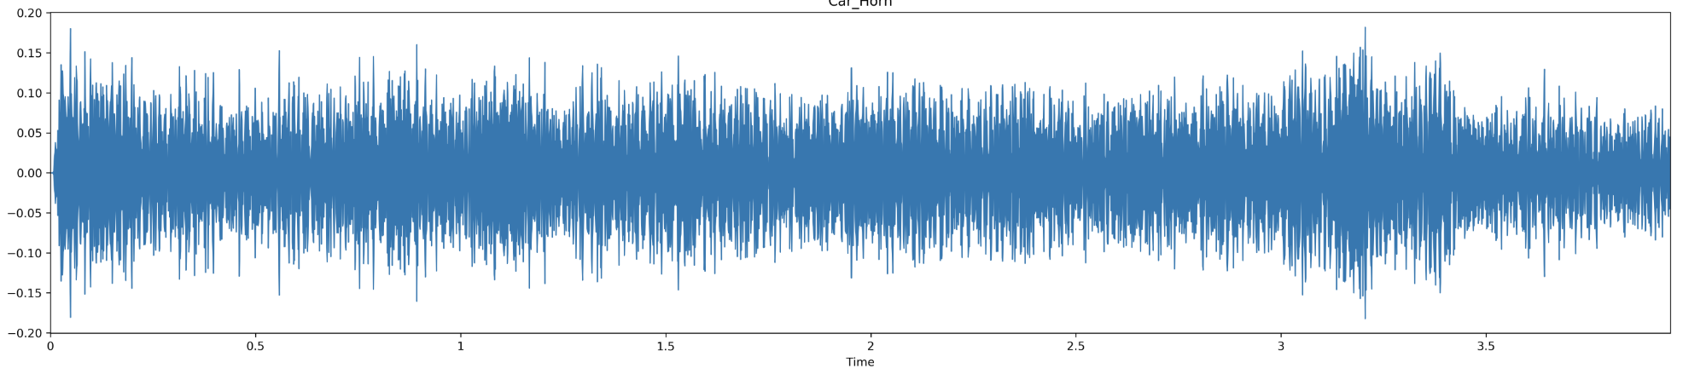
Sound Classifications Cont.
Engine Idling
Jackhammer
Air Conditioner
Car Horn

Slide 5
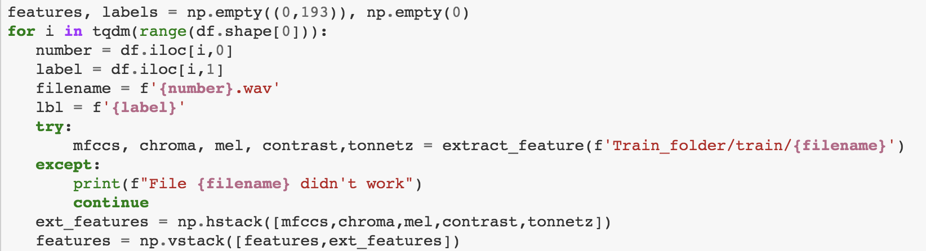
Parse & Labeling
The most important part of the this project was parsing, and labeling the data out of the .wav files and the following code was used
Each file was made up of different types of sound features; mfcss, chroma, mel, contrast and tonnetz
features, labels = np.empty((0,193)), np.empty(0)
for i in tqdm(range(df.shape[0])):
number = df.iloc[i,0]
label = df.iloc[i,1]
filename = f'{number}.wav'
lbl = f'{label}'
try:
mfccs, chroma, mel, contrast,tonnetz = extract_feature(f'Train_folder/train/{filename}')
except:
print(f"File {filename} didn't work")
continue
ext_features = np.hstack([mfccs,chroma,mel,contrast,tonnetz])
features = np.vstack([features,ext_features])

Slide 6
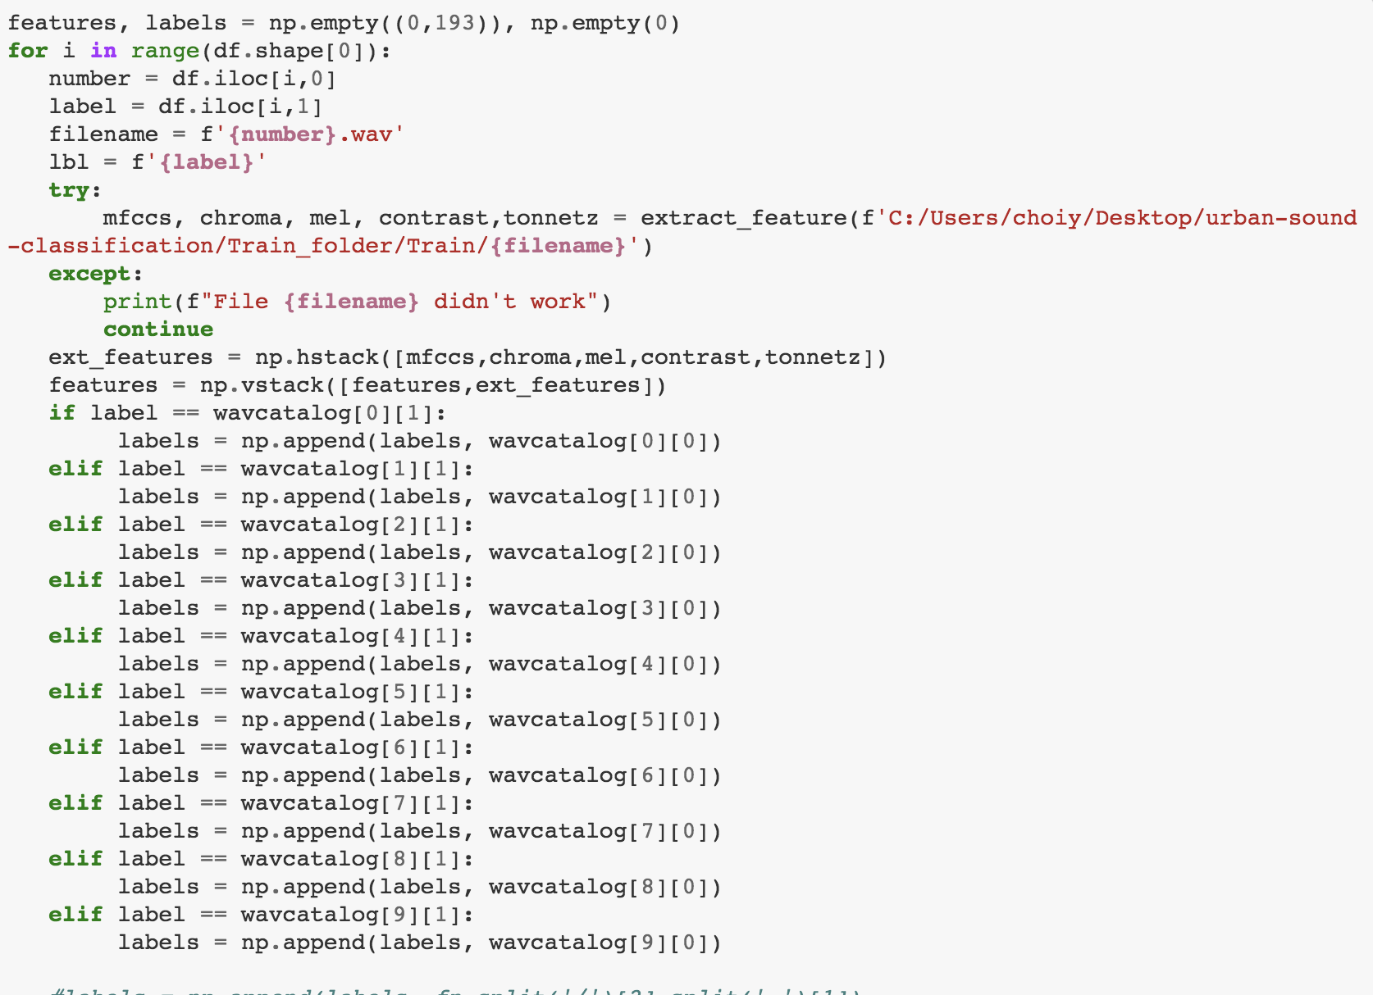
Parsing & Labeling Cont.
f label == wavcatalog[0][1]:
labels = np.append(labels, wavcatalog[0][0])
elif label == wavcatalog[1][1]:
labels = np.append(labels, wavcatalog[1][0])
elif label == wavcatalog[2][1]:
labels = np.append(labels, wavcatalog[2][0])
elif label == wavcatalog[3][1]:
labels = np.append(labels, wavcatalog[3][0])
elif label == wavcatalog[4][1]:
labels = np.append(labels, wavcatalog[4][0])
elif label == wavcatalog[5][1]:
labels = np.append(labels, wavcatalog[5][0])
elif label == wavcatalog[6][1]:
labels = np.append(labels, wavcatalog[6][0])
elif label == wavcatalog[7][1]:
labels = np.append(labels, wavcatalog[7][0])
elif label == wavcatalog[8][1]:
labels = np.append(labels, wavcatalog[8][0])
elif label == wavcatalog[9][1]:
labels = np.append(labels, wavcatalog[9][0])
Python Code:
We created variable called wavcatalog, which stored the labels
There were challenges with the data as most of the files couldn’t initially be read. Therefore, the ffmpeg codec was utilized in order to significantly reduced errors.

Slide 7
Fit
Epochs are the presentation of the data to be learned
We used 200 Epochs to train the data
Data brought back ranges between .74 to .76 accuracy
model.fit(scaled_train_samples, labels, validation_split=0.1, batch_size=10, epochs=200, shuffle=True, verbose=2)
Epoch 193/200
- 1s - loss: 0.5788 - acc: 0.8197 - val_loss: 0.7327 - val_acc: 0.7555
Epoch 194/200
- 1s - loss: 0.5789 - acc: 0.8197 - val_loss: 0.7343 - val_acc: 0.7518
Epoch 195/200
- 1s - loss: 0.5758 - acc: 0.8256 - val_loss: 0.7331 - val_acc: 0.7647
Epoch 196/200
- 1s - loss: 0.5765 - acc: 0.8203 - val_loss: 0.7362 - val_acc: 0.7463
Epoch 197/200
- 1s - loss: 0.5752 - acc: 0.8215 - val_loss: 0.7494 - val_acc: 0.7537
Epoch 198/200
- 1s - loss: 0.5756 - acc: 0.8217 - val_loss: 0.7447 - val_acc: 0.7500
Epoch 199/200
- 1s - loss: 0.5744 - acc: 0.8229 - val_loss: 0.7263 - val_acc: 0.7555
Epoch 200/200
- 1s - loss: 0.5756 - acc: 0.8223 - val_loss: 0.7424 - val_acc: 0.7518

Slide 8
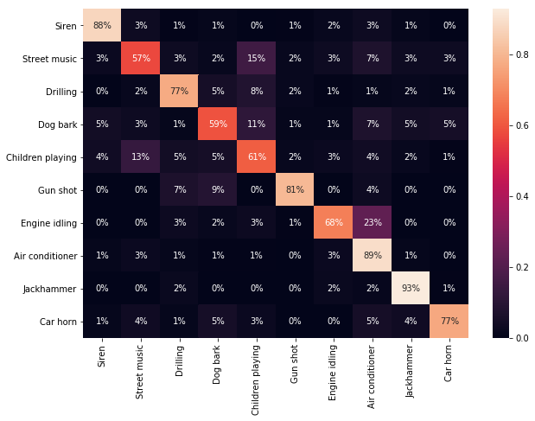
Confusion Matrix Model
Summarizes the performance of a Classification Algorithm, X-Axis = Predicted, Y-Axis = Actual
Example: Data shows Siren data was predicted accurately 88% of the time

Slide 9
K-Nearest Neighbors

Slide 10
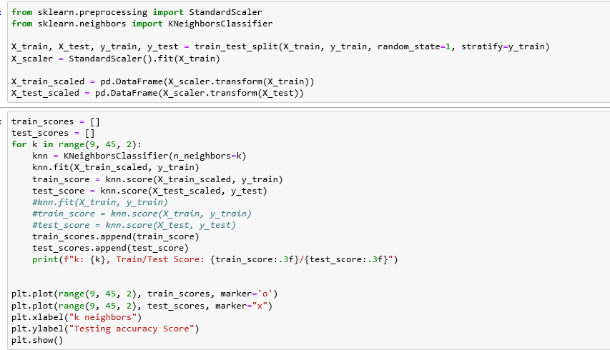

Slide 11
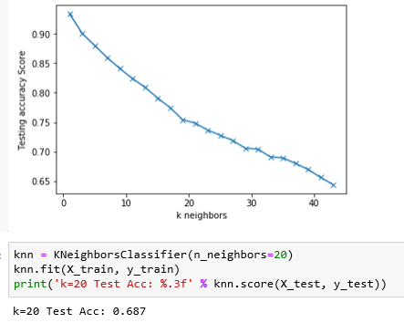

Slide 12
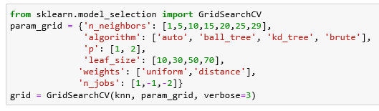

Slide 13
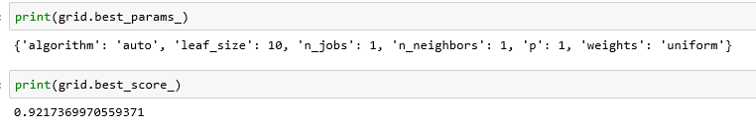
4032 Fits Done:

Slide 14
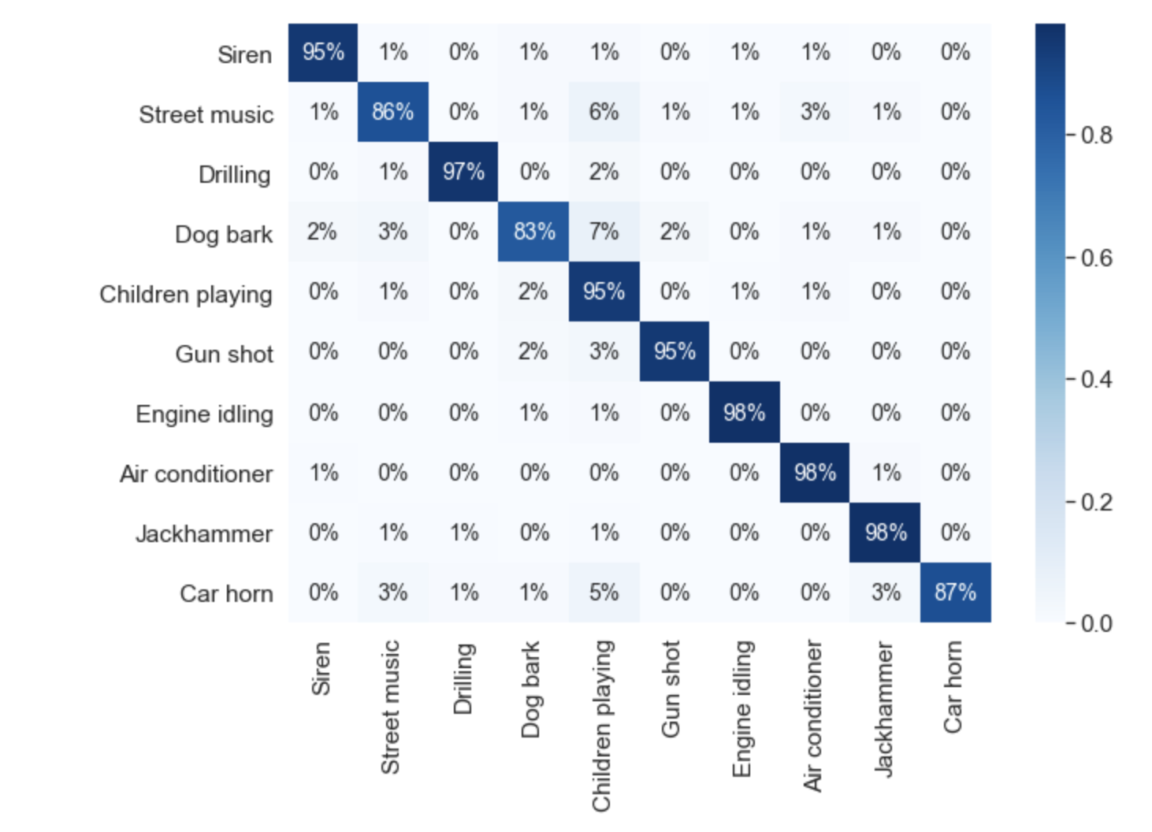

Slide 15
SVM Model

Slide 16
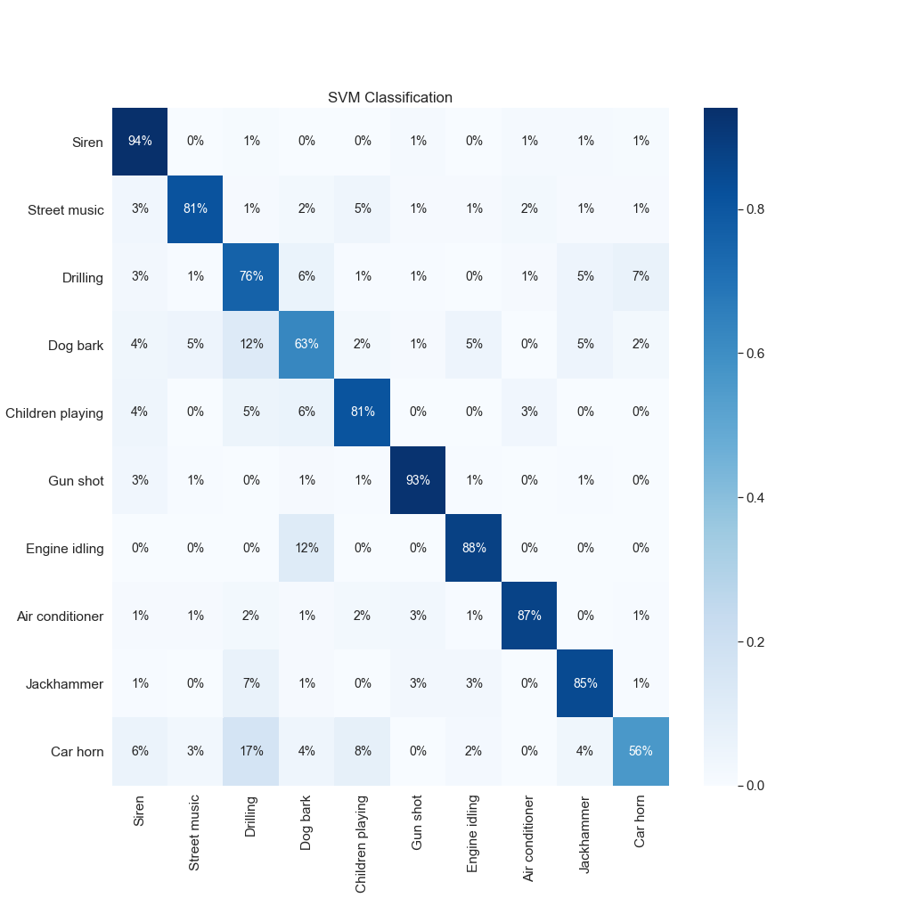
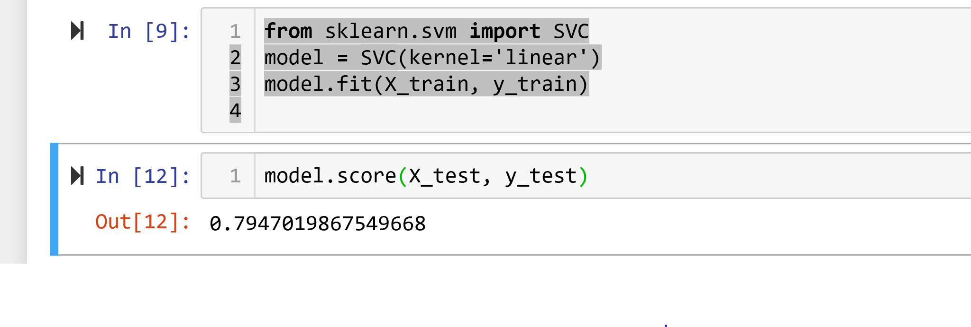
Support Vector Classification
Utilized the Sklearn SVM “linear” SVC kernel to model the data
The initial fitting of the data returned a score of 79.47
With a 94% accuracy rate this model performed best at identifying sirens, but struggled in identifying car horns at 56%

Slide 17
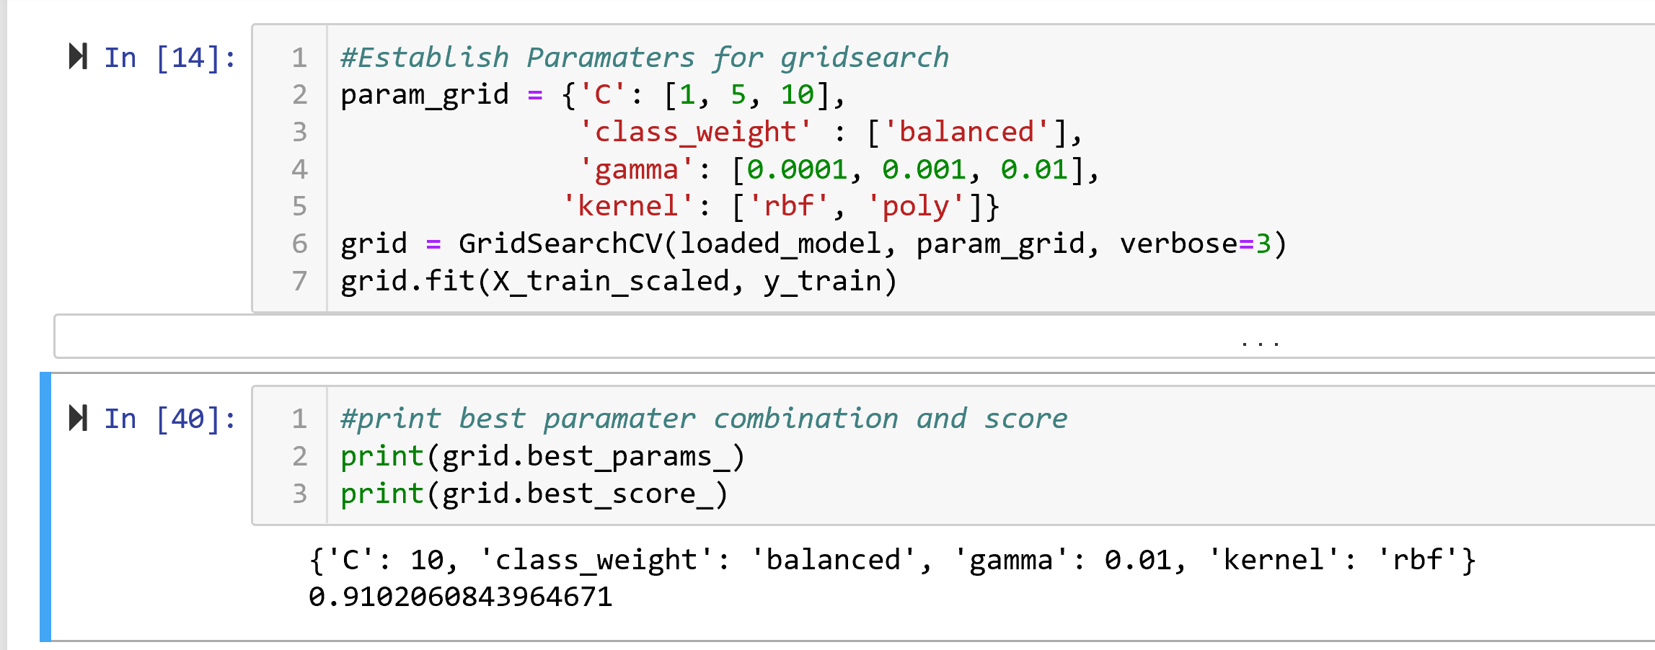
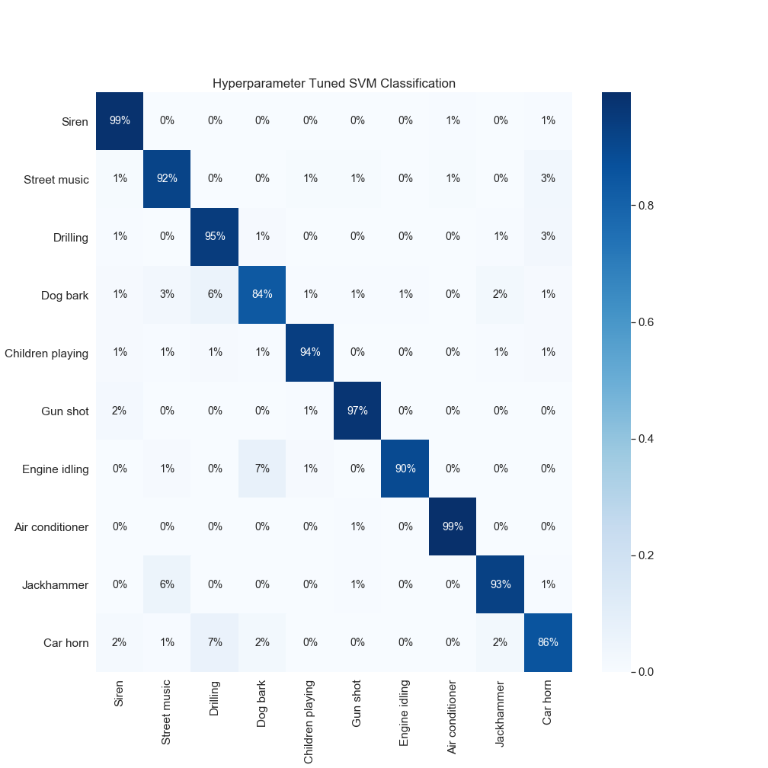
Hyper Parameter Tuning
Utilized the Sklearn Gridsearch to optimize the parameters for the model
Gridsearch was able to identify the best parameters which provided a new score of 91.02
The Siren Accuracy improved to 99% and car horn improved from 56% to 86%

Slide 18
Random Forest

Slide 19
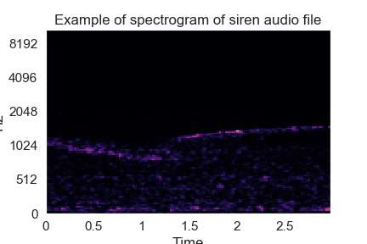

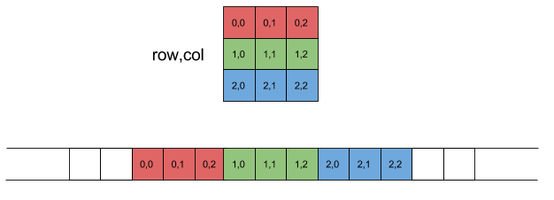
Audio to Images to 2d Array
Audio file specs:
2.97 seconds
128x128 image
128x128 2d array
converted to 1d
dataframe
File sample counts:
8726 files
4636 files

Slide 20
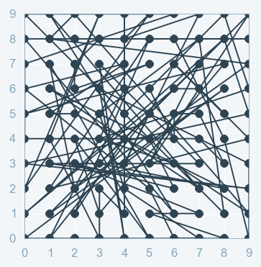
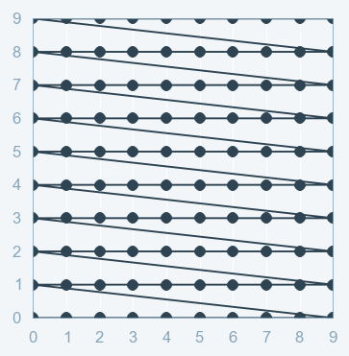


RandomSearch CV GridSearch CV

Slide 21
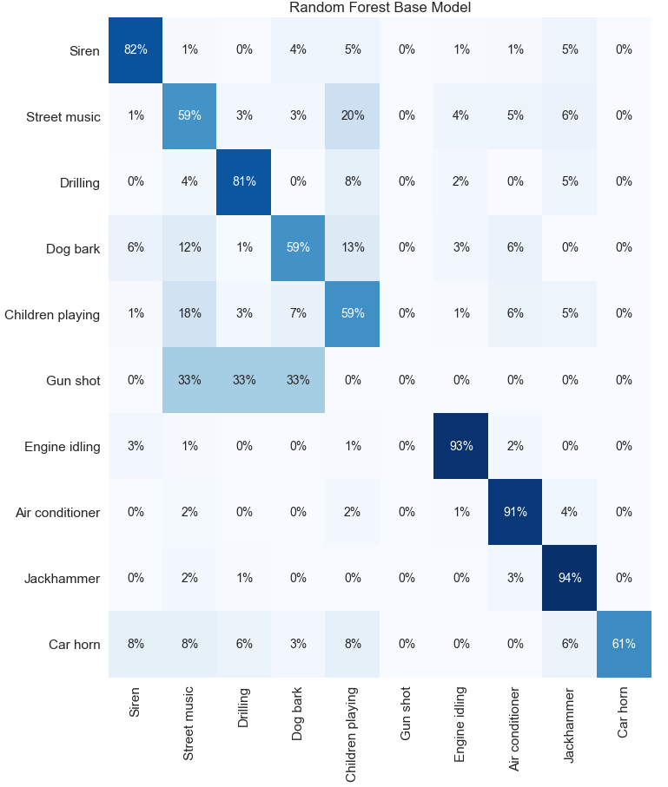
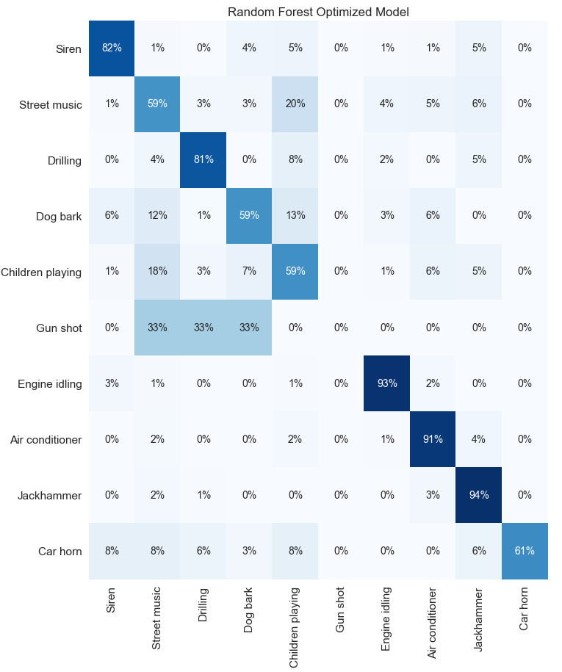
Results of Optimization
Model Performance
Average Error: 0.7429 degrees.
Accuracy = 78.08%.
Correctly Classified: 905.
Model Performance
Average Error: 0.7558 degrees.
Accuracy = 78.26%.
Correctly Classified: 907.

Slide 22
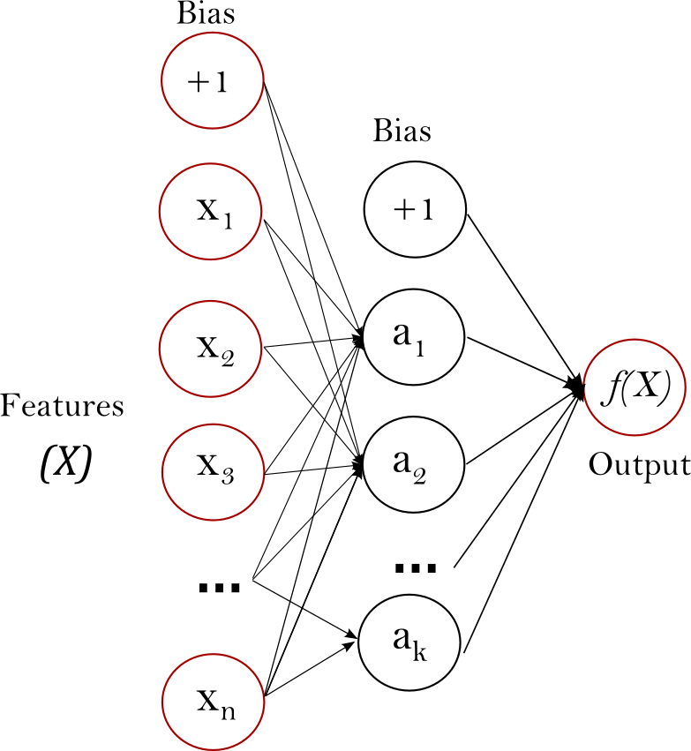
MPLClassifier
Source: https://scikit-learn.org/stable/modules/neural_networks_supervised.html#classification

Slide 23
MLPClassifier
Multilayer Perceptron Classifier is a neural network which uses backpropagation for training.
non-linear
Fitting the training data
Transform data
Split, scale, and score
Step 1
Step 2
Step 3
Step 4
Step 5
Put transformed data into a dataframe
parameters = { 'hidden_layer_sizes':[(100,100)]}

Slide 24
